Slide 1
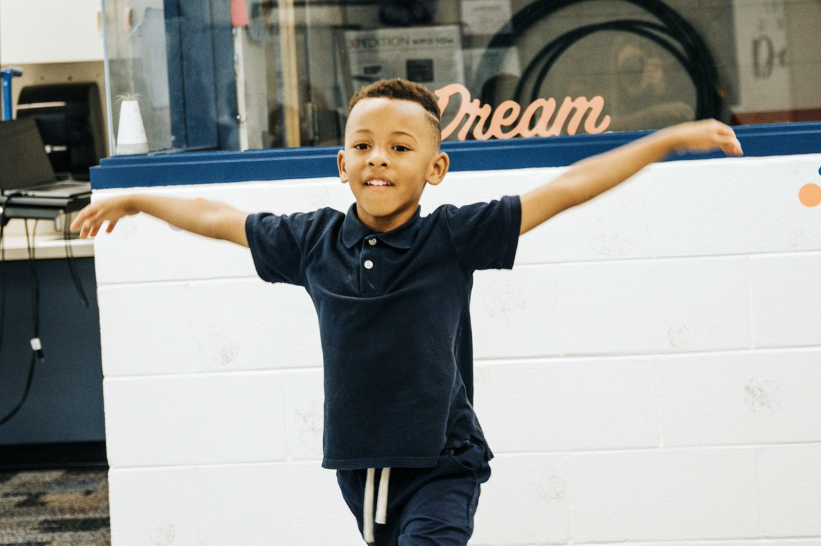
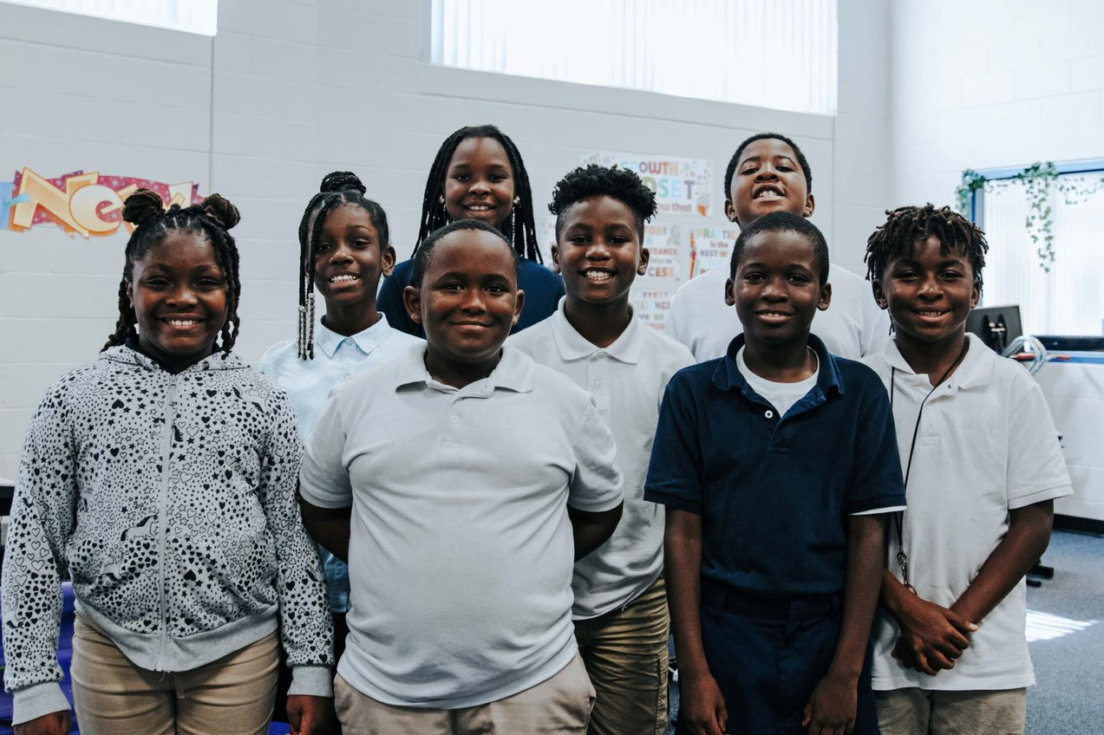
Lakewood Elementary Center for Wellness & Creative Arts
Magnet Coordinator: Thomas Muirhead
Email: Muirheadt@pcsb.org

Slide 2
Center for Wellness and Creative Arts
Vision: Cultivating healthy and resilient leaders!
Mission: Lakewood Elementary provides a learning experience that nourishes wellness and creativity while implementing critical skills, abilities, and knowledge around physical, social, and mental fortitude.
Mantra: We stretch, we challenge, we grow!

Slide 3
Understanding the importance of our magnet program.
LWE students that are registered for the magnet program and graduate from 2024 onward, will have priority registration for the Joint YMCS Wellness and Health middle school.

Slide 4
Magnet Expectations:
Student
Prepared to learn
Participates in classroom activities
Treats others with respect.
Accepts responsibility for their actions
Parent
Student is consistently on time and present (less than 3 absences or lates a marking period).
Is supportive and respectful
Response to teacher communications when necessary.
Engages child about his or her school activities
Supports student and school activities

Slide 5
Discovery Night 1/19/23
6pm- 7:30pm

Slide 7
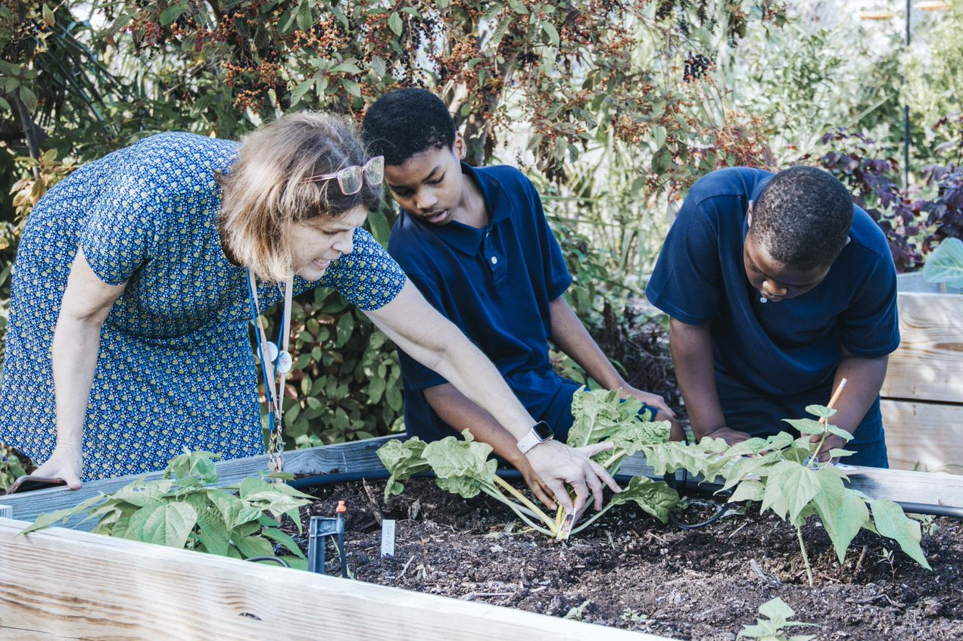
Teaching Wellness
Physical
Mental
Emotional
Social
Nutritional
Intellectual & Academic
Environmental
Financial
Traditions & Values

